Slide 1


Publix's Integrated Data System For Supply Chain and Sales and Marketing Analysis
Group 7
Teagan Milford, Krittika Deshwal, Sankalp Kulkarni,
Rafain Rodriguez San Millan, Mansi Sharma
McCombs School of Business
University of Texas at Austin
November 27, 2023

Slide 2

Agenda
Introduction & Problem Statement
Sales Analytics and Insights
Data Management Strategy
Challenges and Future Steps
Publix Real-Time Tracking Database
Acknowledgements

Slide 3
Introduction
Publix is a major supermarket chain in the Southeastern United States. It has over 1,300 stores, and generated a revenue of $41.1 billion in 2021
Their information management strategy has to serve different business units, ensuring data consistency, and helping the business operation
This project will show how two information systems from Publix achieve this while keeping consistency across the organization

Slide 4


Problem Definition
Supply Chain Department
Sales Department
Supply chains face all kind of challenges, a primary one being able to track products and their different relationships. Our first system Publix Real-Time Tracking Database:
The Sales Team is looking to understand it’s customer’s shopping behaviors to be able to better target their customers. But their legacy data management has several challenges:
Tracks and follow products in the supply chain
Stores all the information related to a product and their relationships
Helps identifying critical parts of the supply chain
Avoids overloading resources and destination errors
Disintegrated Reporting and Data duplication
Need to combine data from different sources for analysis
Analyzing Customer Purchase Patterns
Sharing real-time POS data with other departments

Slide 5
Publix Real-Time Tracking Database

Slide 6
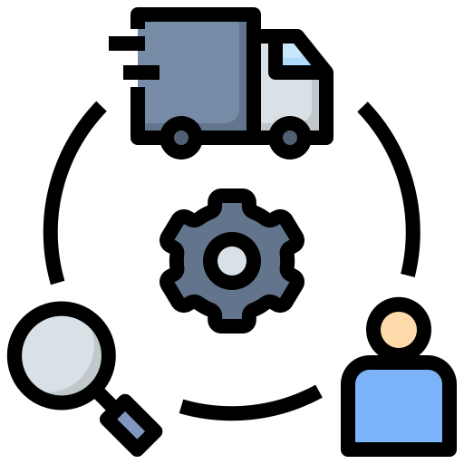
Data Management Strategy & Information Sources
This system is intended as a working prototype for Publix. For this reason we created our own data following Publix business model
Some of the objects we created are: Products, Warehouses, Stores, Drivers, etc…
Carefully made sure that both systems shared the same information by keeping consistent Multiple Versions of the Truth

Slide 7


Overview
Using Neo4j graphical database for building Publix Real-Time Tracking Database
A graphical database gives us the freedom to represent the different relationships between entities in our supply chain model
Allows us to understand the status of the supply chain at any given time

Slide 8
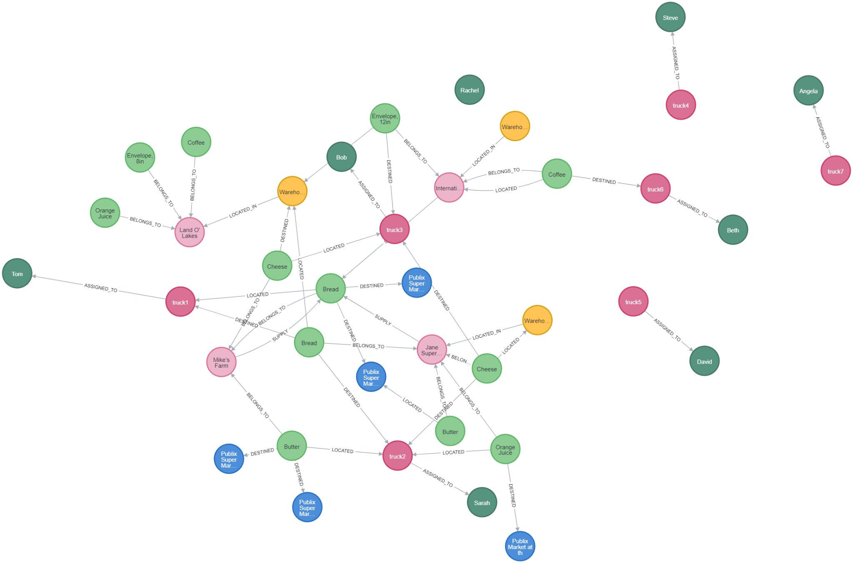

Slide 9
“This is Brad, the manager at Publix store #2811 at Champions Gate Village. I’m calling to check in on our order of bread. Can you please give me an update on its status?”

Slide 10
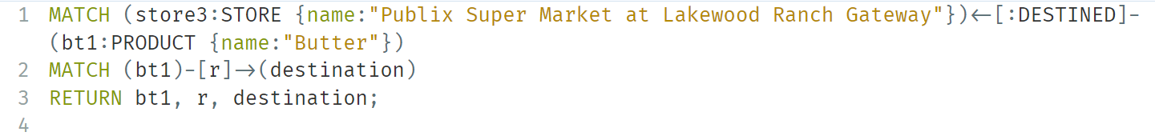
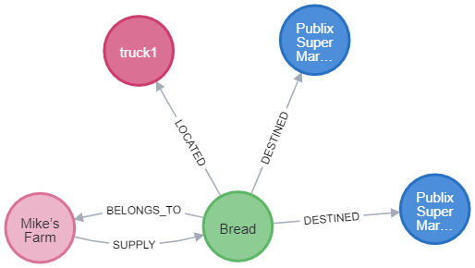

Slide 11
“Hi, this is Mike from Mike’s farms. I’m calling to see if Tom is still driving for Publix? I’ve been trying to get a hold of him.”

Slide 12
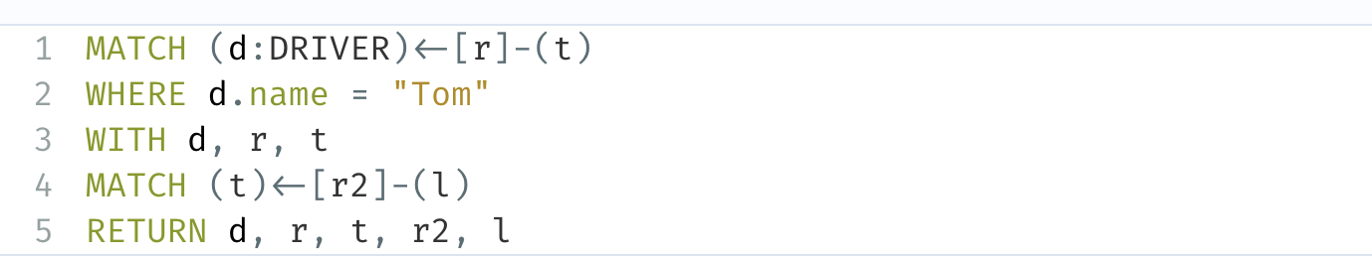
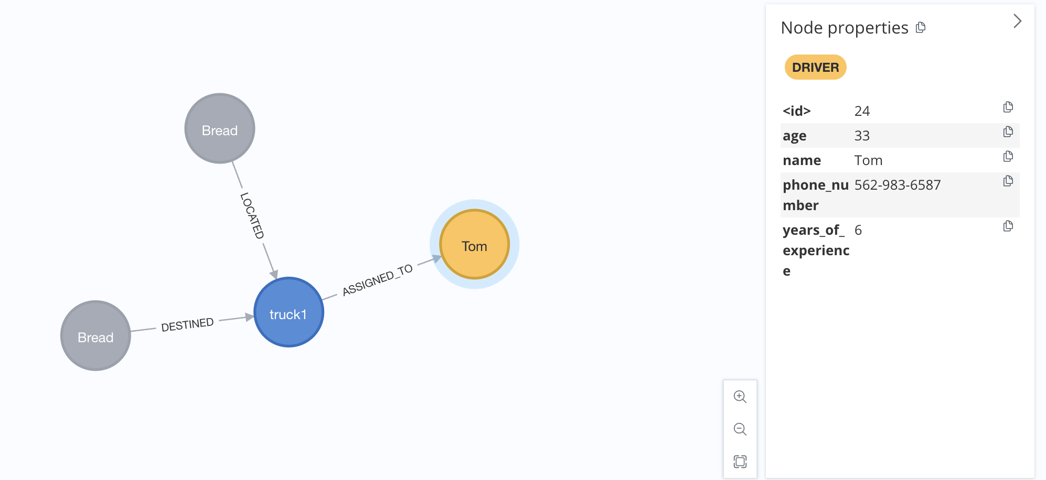

Slide 13
“This is Kim from International Paper Inc. We sent out some 12-inch envelopes earlier in the week that were supposed to be 8-inch envelopes. Can you locate the shipment so we can fix our mistake?”

Slide 14
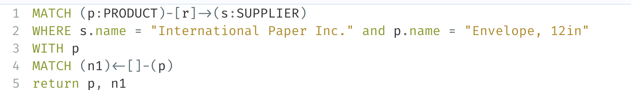
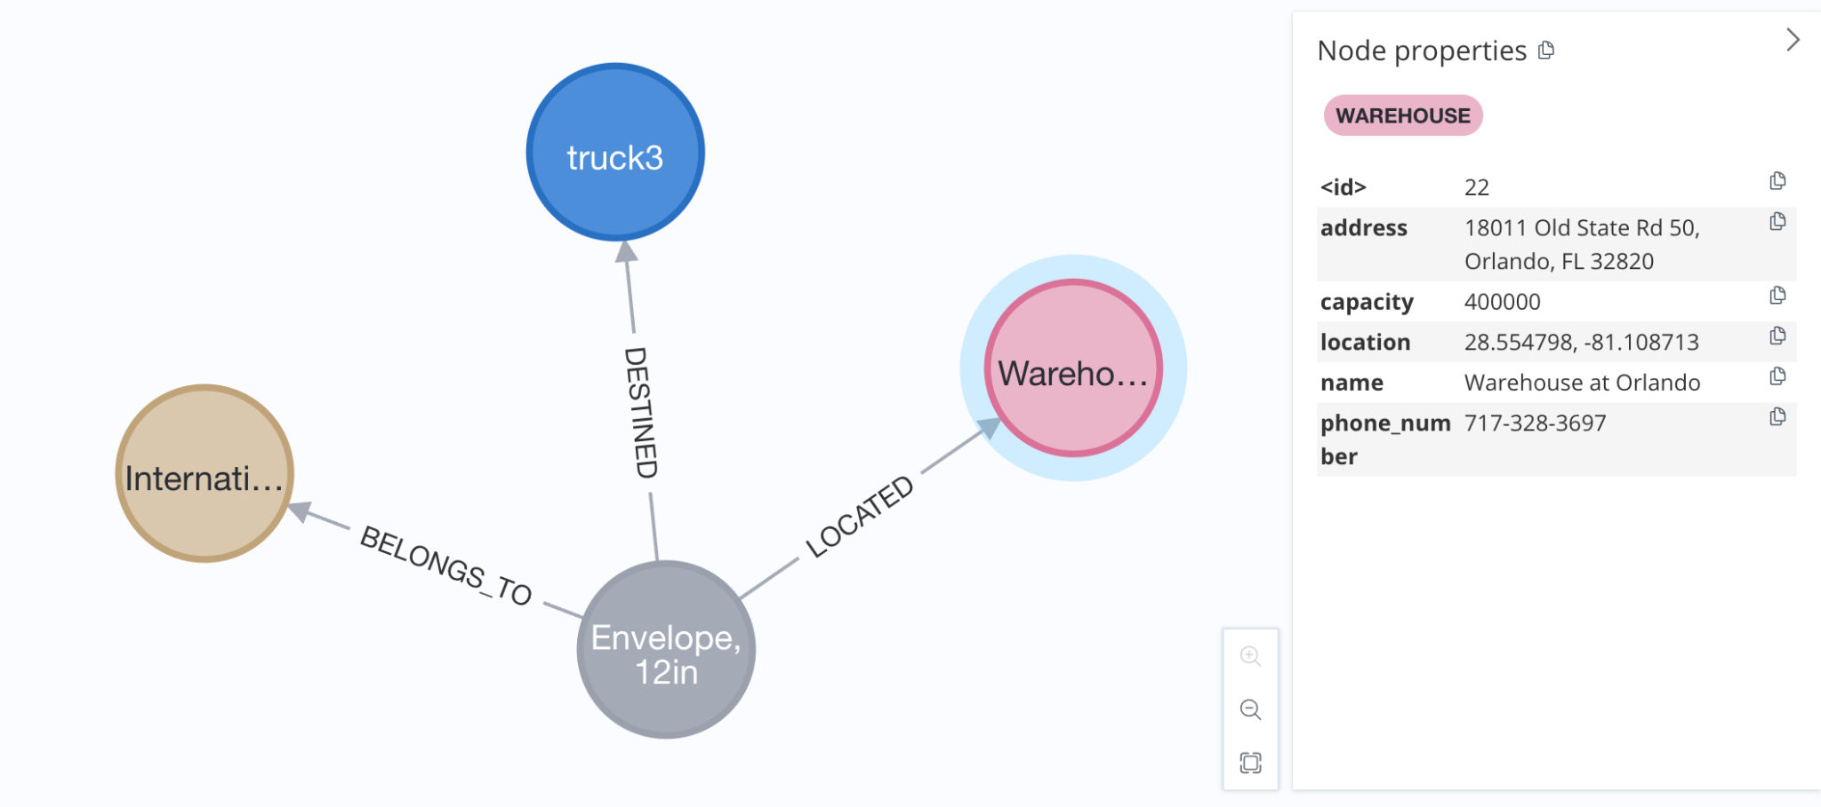

Slide 15
Sales Department System
40%
80%
60%
30%
70%
55%
55%
35%

Slide 16
Data Management Strategy & Role
Data Management Tools
Strategy and Design
Oracle
MongoDB
Action Plan
Goal
Efficient in managing complex, multi-field queries, essential for in-depth exploratory data analysis
With it’s flexible document schemas &
powerful querying and analytics
Identify the data entities, relationships, and constraints we need for our analysis
To create a robust, scalable & efficient system which helps the Sales Team​

Slide 17
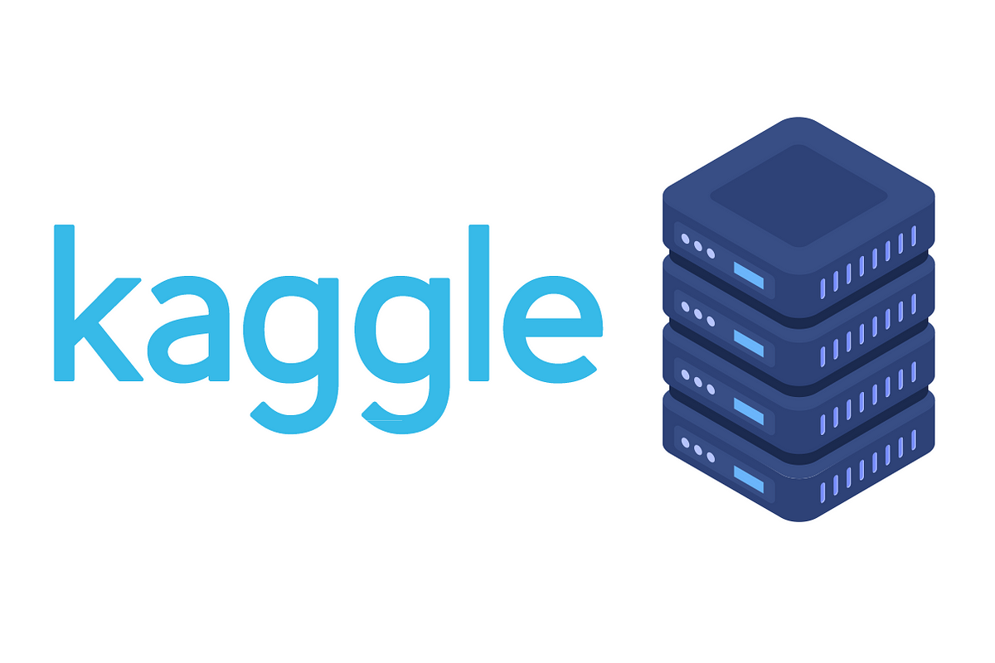


Data Processing Pipeline
Data Collection
Sampled a dataset from Kaggle for an Online Grocery Store
Data Storage
Initially we use Oracle to create and store a relational set of 4 CSVs
Data Manipulation
Create different cross-sections of the data to serve Sales team’s use-cases
Data Analysis
MongoDB’s powerful visualizations allow us to showcase our findings
Notes:
Data collection, storage, manipulation, and analysis are all steps of the data processing pipeline. This pipeline represents the sequence of actions involved in handling data from its initial collection to extracting meaningful insights. Each step plays a crucial role in managing and deriving value from the available data:
Data Collection: Gathering raw data from various sources, whether it's through sensors, surveys, transactions, or other means.
Data Storage: Storing the collected data in a structured and organized manner, often in databases or data warehouses, for easy retrieval and future use.
Data Manipulation: Preparing and cleaning the data to ensure its quality and relevance. This step may involve filtering, transforming, or combining data sets.
Data Analysis: Applying various techniques, such as statistical analysis, machine learning, or other analytical methods, to extract meaningful insights and patterns from the data.

Slide 18
Business Questions
Customer Shopping Behaviour
In order to predict when they reorder and how they can be segmented
Analysing Order Frequency
Understand peak purchasing times and days of the week for targeted promotional activities
Best Selling Products/Department/Aisle
Which are the fastest moving products?

Slide 19
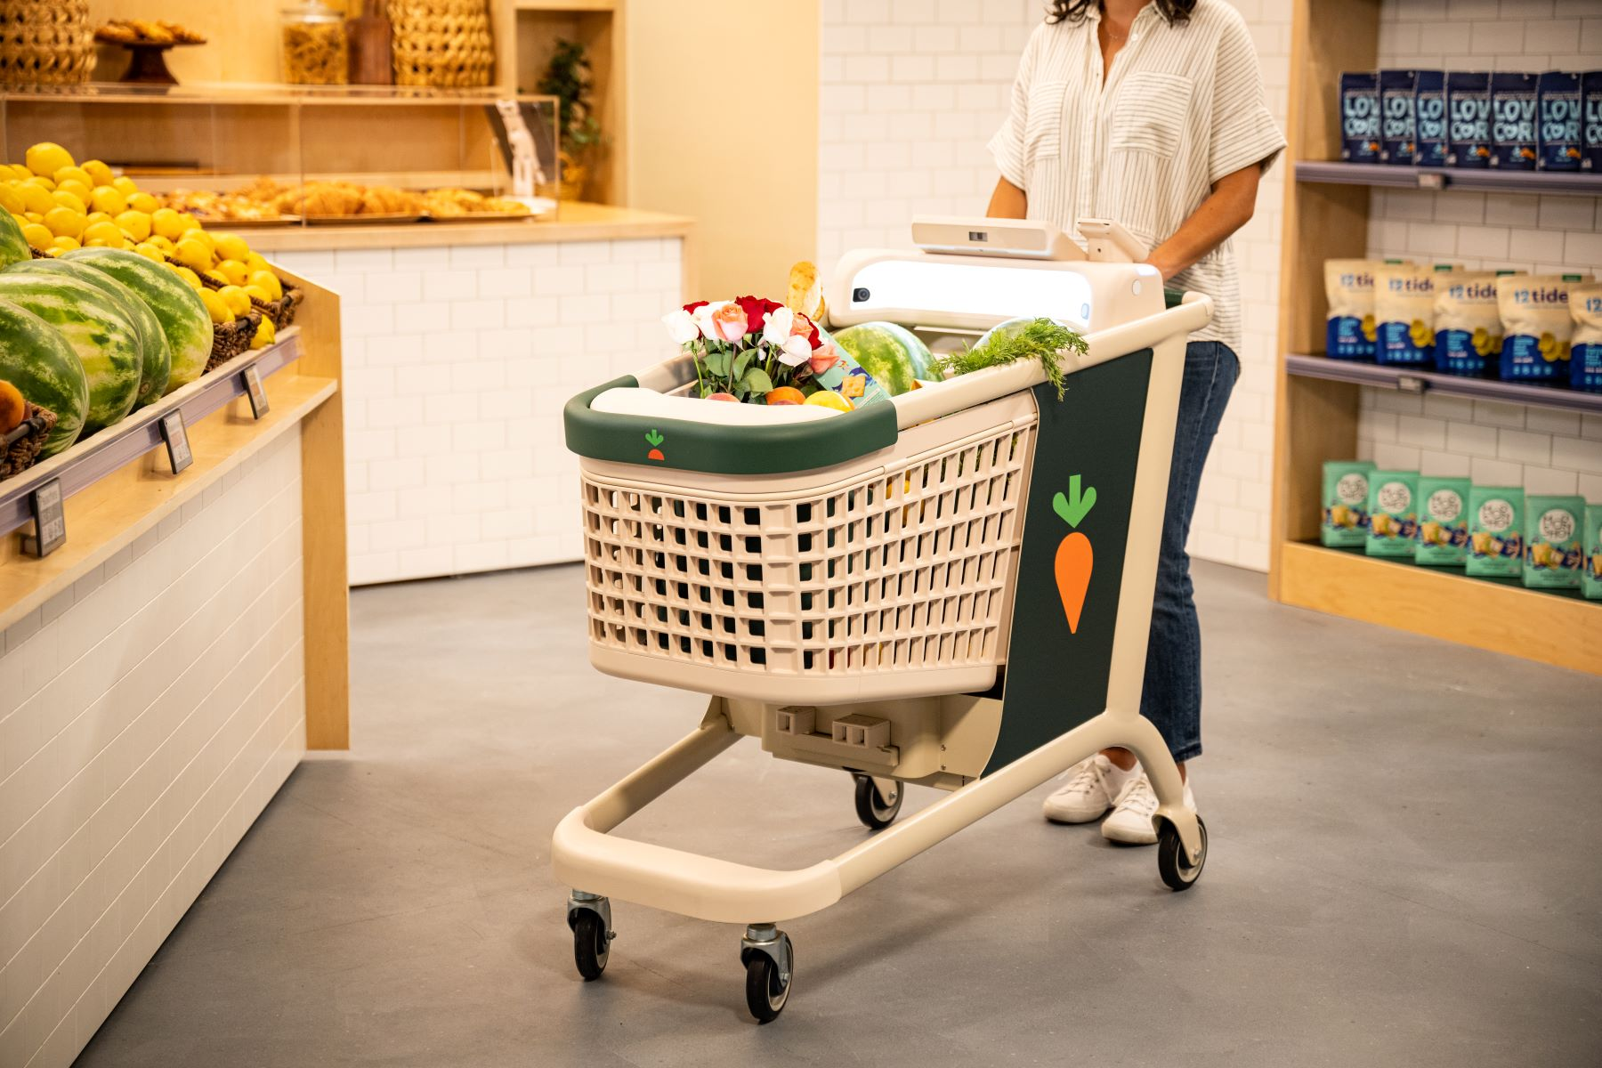


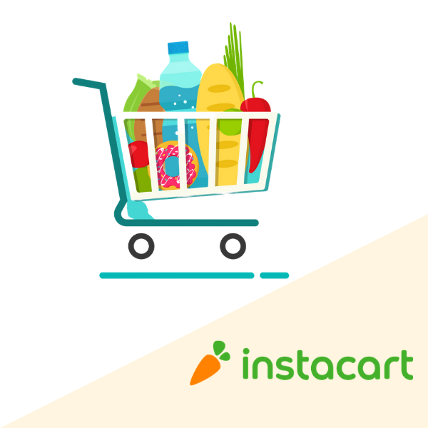
Data Overview
10k + Total Orders
134 Aisles
49k+ Products
21 Departments

Slide 20
Data Overview
Aisle
Department
Product
Orders
Aisle Information (instant foods, specialty cheeses, etc)
Department Information (Beverages, Bakery, etc.)
Individual Product Information
Contains order details for each User ID
Columns:
Aisle ID and Name
Columns:
Department ID and Name
Columns:
Product ID, Name, Aisle ID and Department ID
Columns:
Order ID, User_ID, Product ID, Order Number, Day of Week, Hour of Day and Days since Prior Order

Slide 21
Data Pipeline: From Structure to Insights
Create Database & Schemas
Exploratory Data Analysis
Formulating Queries for Business Questions & Visualizations
Notes:
To transform raw data into actionable insights . These steps are often part of the data science and analytics workflow.
Create Database & Schemas:
Purpose: Establish a structured environment to store and organize data.
Actions: Design and create a database, define schemas (structure of the data), and set up tables to store information in a systematic way.
Exploratory Data Analysis (EDA):
Purpose: Understand the characteristics of the data, identify patterns, relationships, and potential outliers.
Actions: Descriptive statistics, summary visualizations, and initial statistical analyses to gain insights into the dataset.
Visualizations:
Purpose: Communicate insights and patterns in the data effectively.
Actions: Create graphical representations (charts, graphs, plots) of the data to make complex information more understandable and to support decision-making.

Slide 22
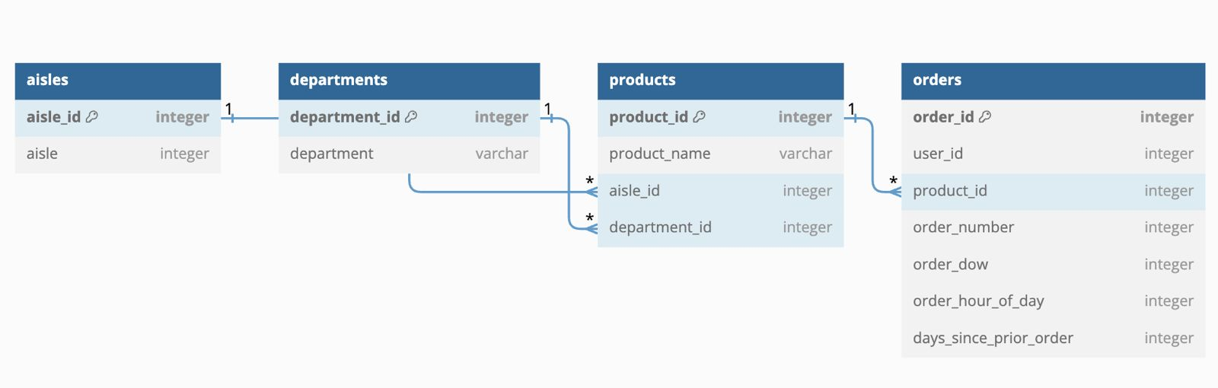
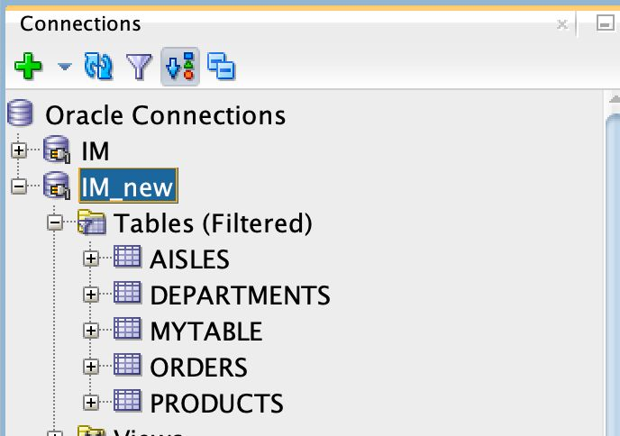
Data Pipeline: From Structure to Insights
Create Database & Schemas
Notes:
To transform raw data into actionable insights . These steps are often part of the data science and analytics workflow.
Create Database & Schemas:
Purpose: Establish a structured environment to store and organize data.
Actions: Design and create a database, define schemas (structure of the data), and set up tables to store information in a systematic way.
Exploratory Data Analysis (EDA):
Purpose: Understand the characteristics of the data, identify patterns, relationships, and potential outliers.
Actions: Descriptive statistics, summary visualizations, and initial statistical analyses to gain insights into the dataset.
Visualizations:
Purpose: Communicate insights and patterns in the data effectively.
Actions: Create graphical representations (charts, graphs, plots) of the data to make complex information more understandable and to support decision-making.

Slide 23


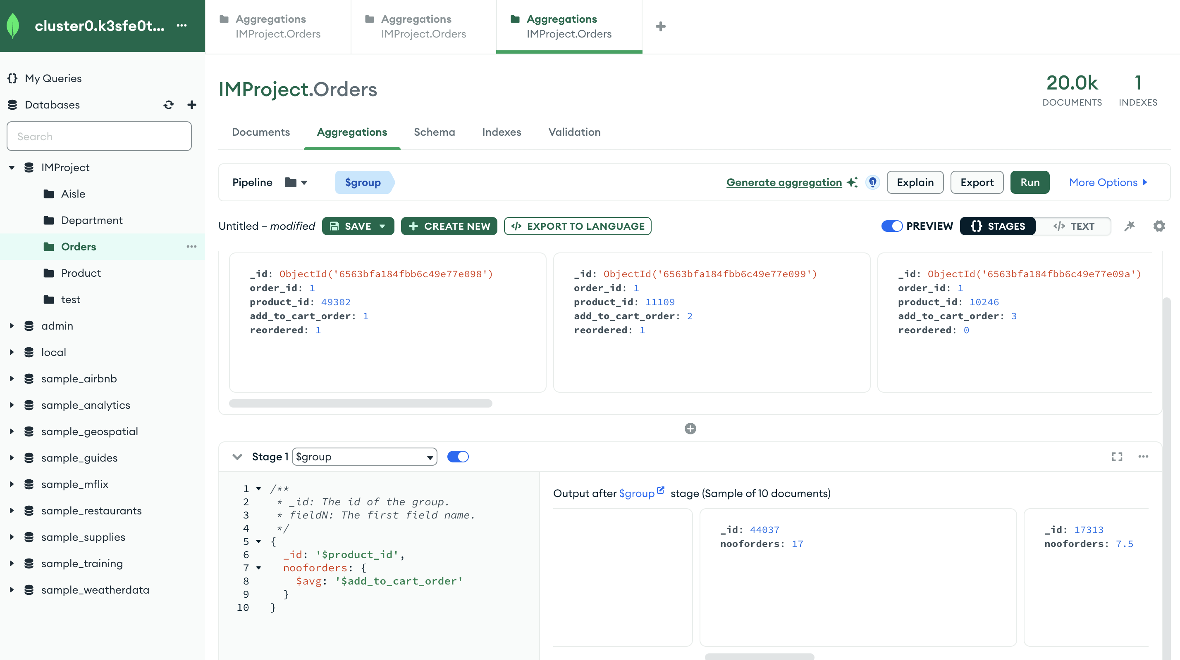
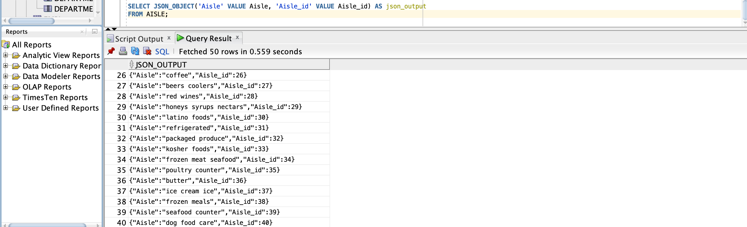
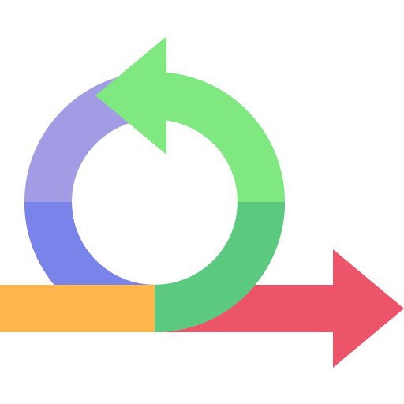

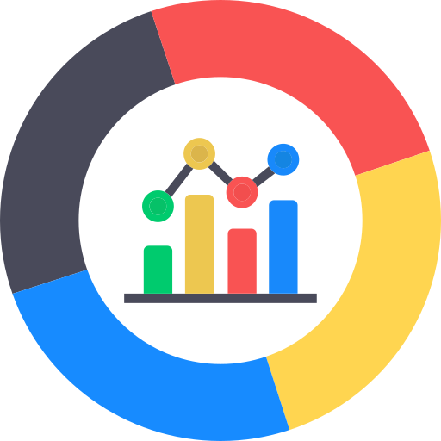
Data Pipeline: Towards Agile Development
Agile Development
Flexible Schemas
Analytical Capabilities

Slide 24

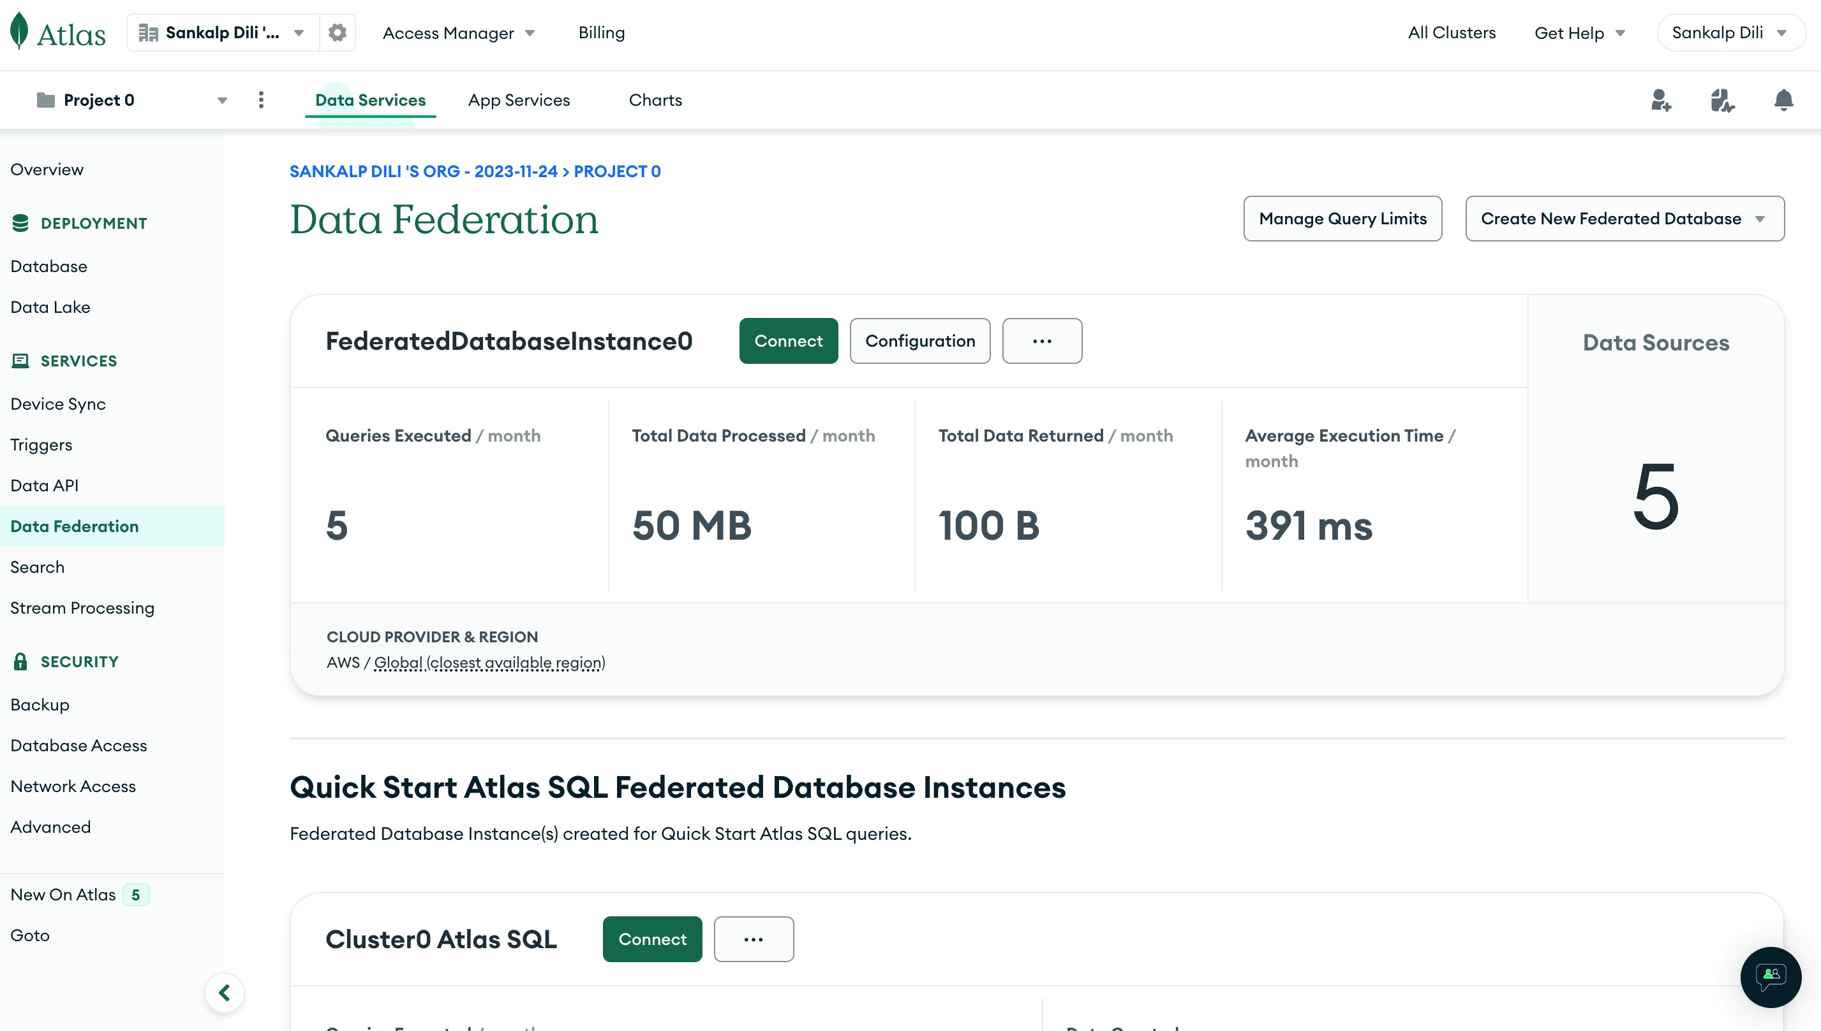


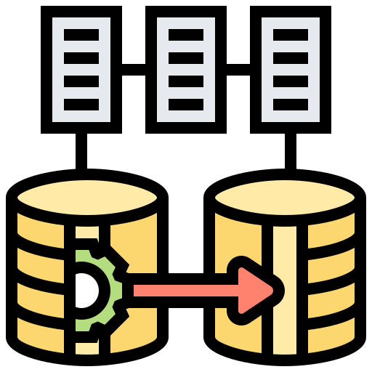
Data Pipeline: Future-Proofing Of The System
Automatic Scaling
Compatible
(Cloud Providers)
Ease of Migration

Slide 25
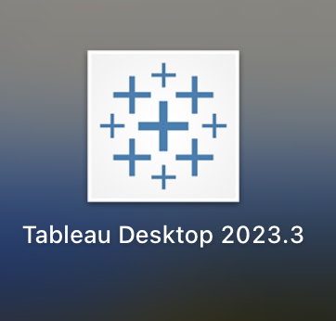
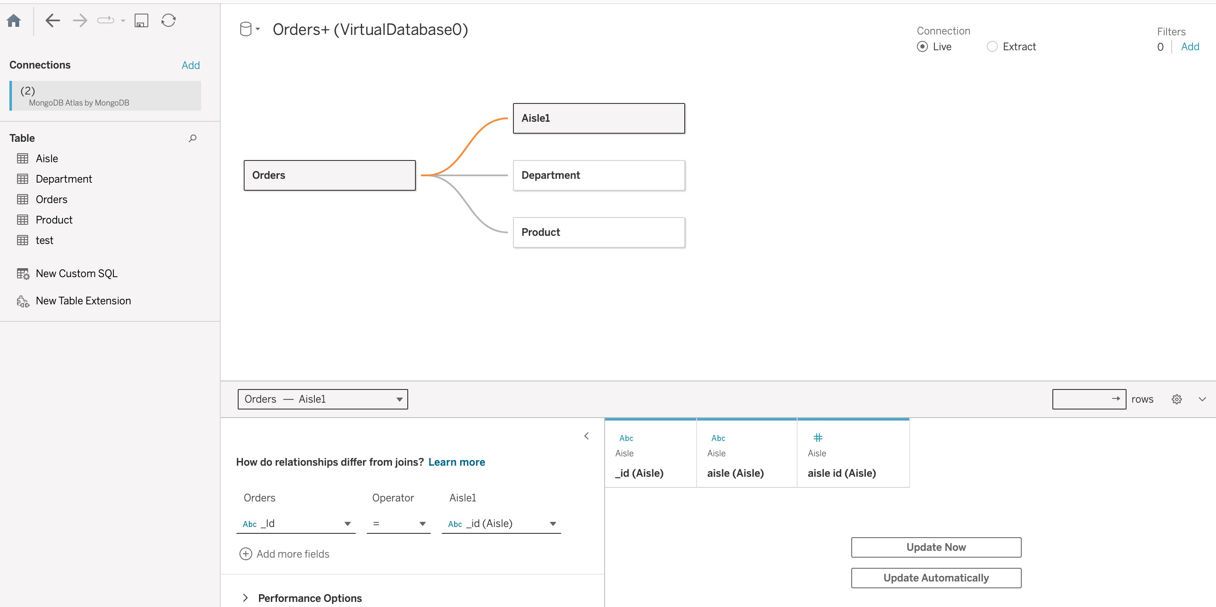


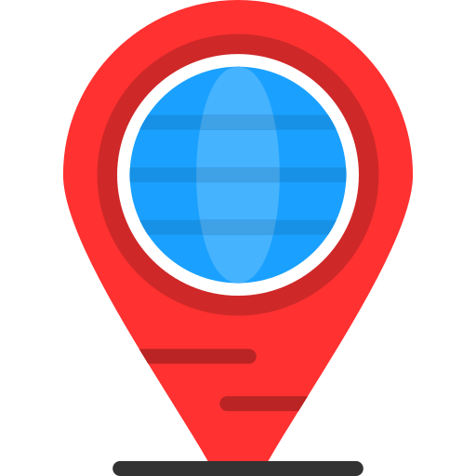
Data Pipeline: Strategic Integration
Development Speed
Aggregation Framework
Geospatial Capabilities

Slide 26
Business Questions
01
Customer Shopping Behaviour
Notes:
Links:
https://www.pexels.com/photo/photo-of-people-holding-each-other-s-hands-3184434/

Slide 27
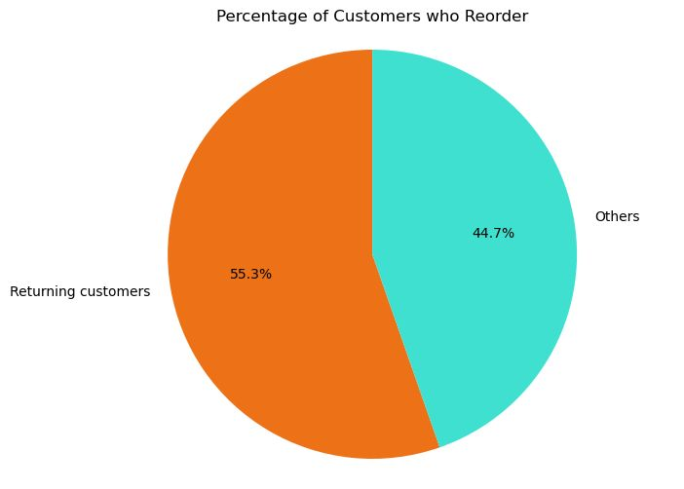

How many are Loyal Customers?
A little over 50% of the customers are known to re-order

Slide 28
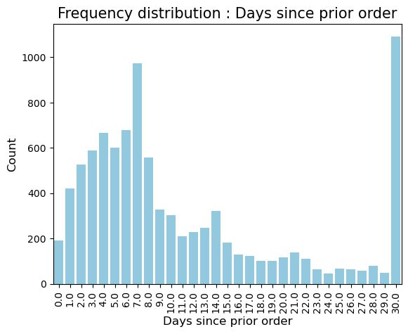
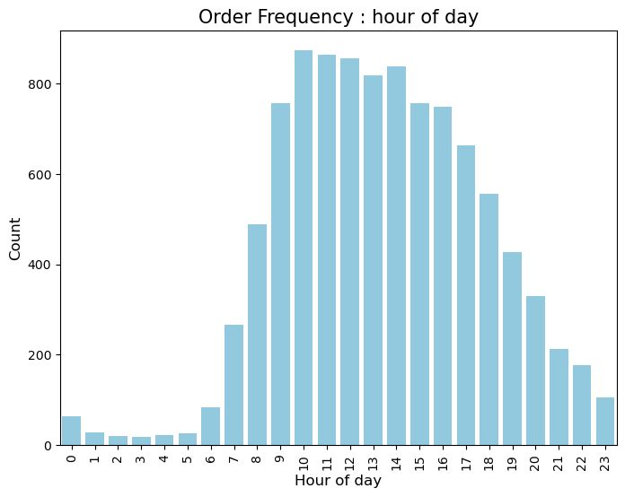
Customer Shopping Behavior
Most orders are re-ordered either within 7 days or after 30 days, implying frequent buyers and bulk buyers
The 9 to 5 window sees maximum influx of orders

Slide 29
Business Questions
02
Analysing Order Frequency
Notes:
Links:
https://www.pexels.com/photo/photo-of-people-holding-each-other-s-hands-3184434/

Slide 30
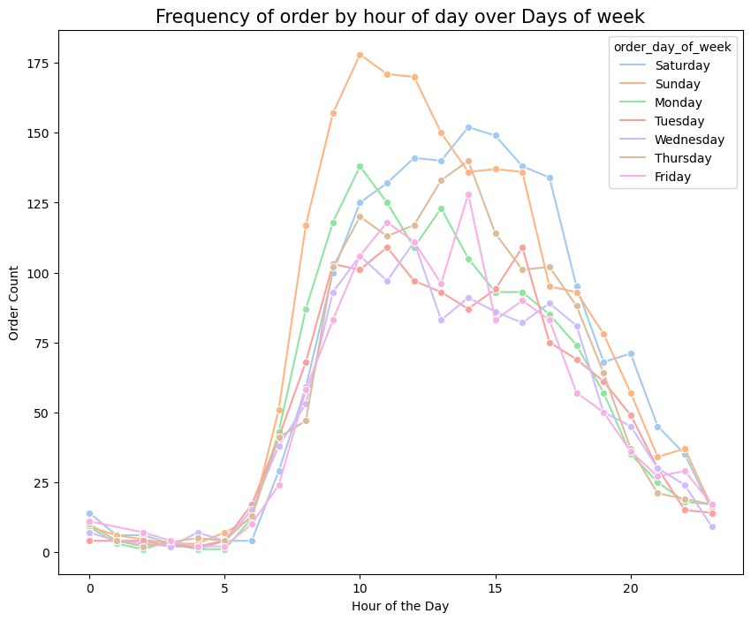




Analysing Order Frequency

Slide 31
Business Questions
03
Best Selling Products/ Department/ Aisle
Notes:
Links:
https://www.pexels.com/photo/photo-of-people-holding-each-other-s-hands-3184434/

Slide 32
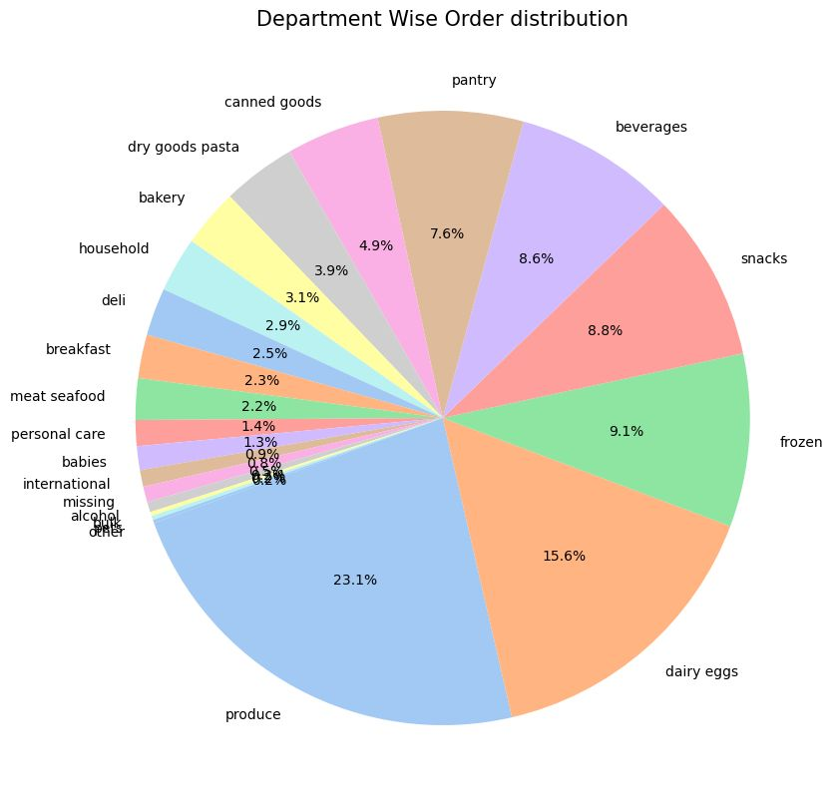
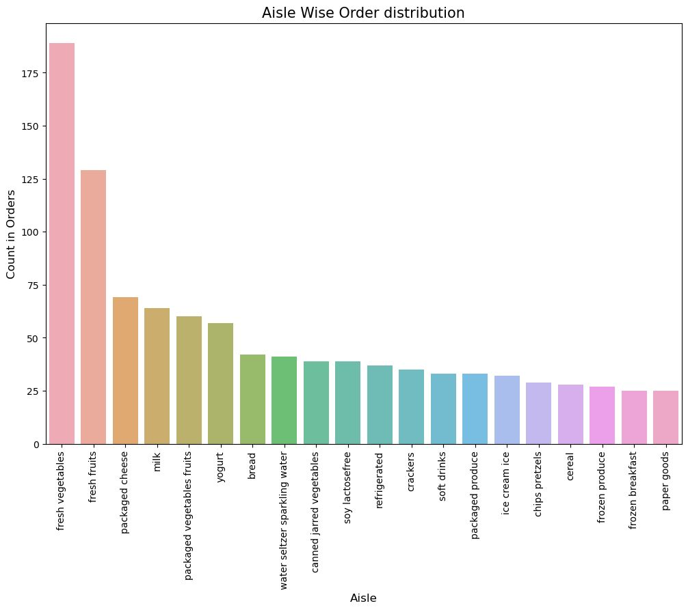
Best Selling Products/ Department/ Aisle
In sync with department sales, fresh produce and dairy products in most orders!
Fresh Produce has the highest number of orders closely followed by Dairy/ Eggs!

Slide 33
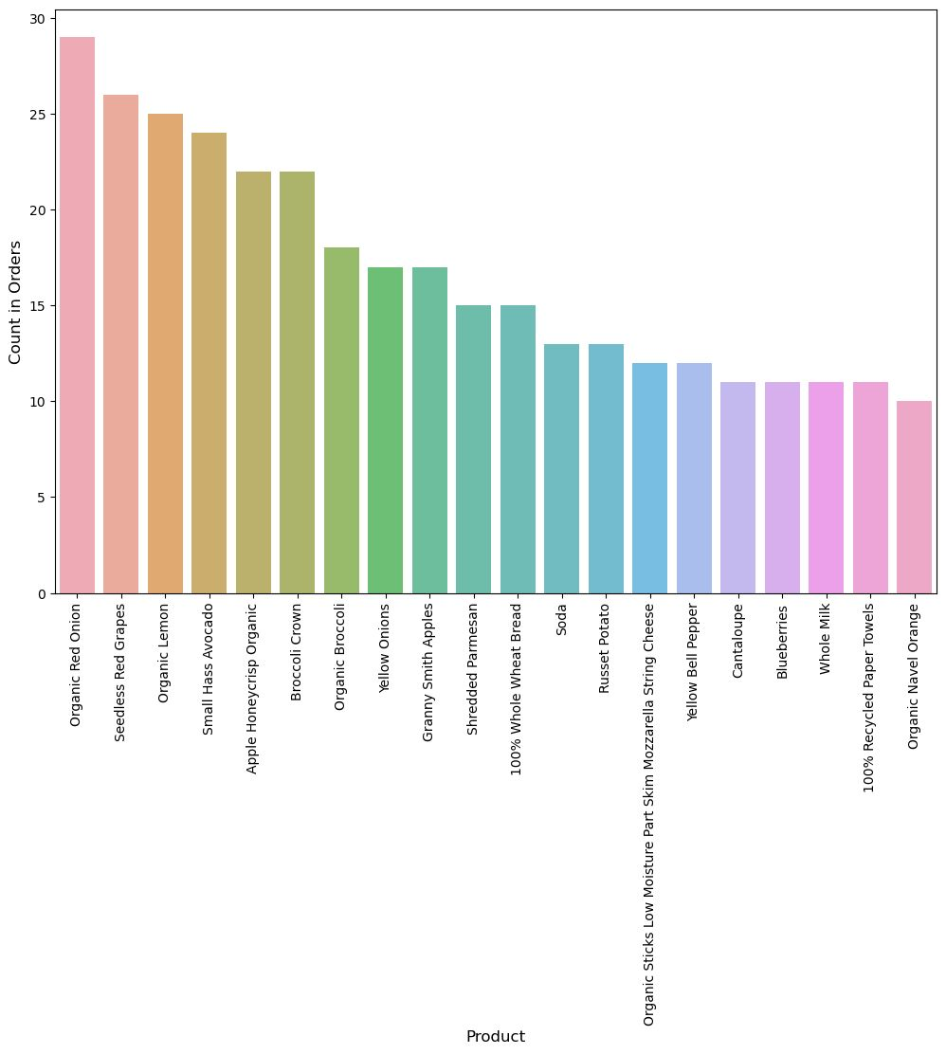

Best Selling Products/ Department/ Aisle
These are the top 20 products by volume sold and we see a clear preference for Organic Produce!

Slide 34
Key Takeaways
01
scenarios where relationships are a primary focus, and graph traversal is a core requirement
Neo4j
02
versatile use cases, where a mature and feature-rich RDBMS is necessary
OracleDB
It’s a continuous process
03
need a flexible schema and want to scale horizontally to handle large amounts of data
MongoDB

Slide 35
Future Steps
01
Identifying Clusters/ Customer Segmentation
02
Customer Targeting
Applications
03
Recommender System using Collaborative Filtering

Slide 36
THANK YOU!

